Slide 1

All Campus Meeting
Budget Discussion
October 26, 2018

Slide 2
College 6 Retirement Comparison
- Unverified and Subject to Change -

Slide 3
Retirement Contribution Savings
Service Group | Counts | Initial IRS Limited Salary | Current Plan ER Contribution | Current Contribution | Proposed Contribution 5% |  |  | Proposed Contribution Model B |  |  | Proposed Contribution Model C
1-5 years | 155 | $12,583,862 | 5% | $629,193 | $629,193 |  | 1:1 Match 1-2% 3%EE = 4%ER | $503,354 |  | 1:1 Match 1-3% | $377,516
6-10 years | 52 | $4,951,219 | 7% | $346,585 | $247,561 |  | 1:1 Match 1-2% 3%EE = 5%ER | $247,561 |  | 1:1 Match 1-2% 3%EE = 5%ER | $247,561
11+ years | 157 | $15,108,506 | 10% | $1,510,851 | $755,425 |  | 1:1 Match 1-2% 3%EE = 6%ER | $906,510 |  | 1:1 Match 1-2% 3%EE = 7%ER | $1,057,595
Total | 364 | $32,643,586 |  | $2,486,629 | $1,632,179 |  |  | $1,657,426 |  |  | $1,682,672
 |  |  | Annual Savings | $854,450 |  |  |  | $829,203 |  |  | $803,957
 |  |  | 7/12 Savings | $498,429 |  |  |  | $483,702 |  |  | $468,975

Slide 4
Spousal Carve Out
A spouse of a University of Findlay employee is required to participate in his/her employer sponsored health care plan if the spouse has access to continuous group health coverage through his/her employment, and the employer contributes at least 50 percent of the premium. If these conditions are met, the spouse must enroll in his/her employer’s health care plan. The spouse will be permitted to remain on the University of Findlay’s plan for secondary health care coverage.

Slide 5
Non-Emergency Imaging Management
Program would require all non-emergency outpatient imaging to go through prior authorization. Additionally the program would apply a maximum for MRI and CT scans.

Slide 6
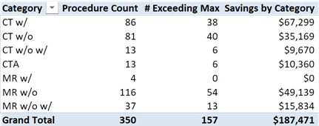
Imaging Max
The above is only 10 months’ worth of data.
When annualized the savings is $225,000

