Slide 1
Online @ UF Updates &
LMS Review 2017
C. Damon Osborne, Ph.D.​
AVP for Online and Alternative Delivery Programs
Carolyn Kraut, M.Ed.​
Online Instructional Designer

Slide 2
Training Opportunities
Teaching Online @ UF​
Quality Matters​
ATS – skills/tools​
Tuesday Teas w/Dr. D

Slide 3
Support
Carolyn Kraut – Online Instructional Designer​
ATS​
Matt Kraut – COB and COE​
Emily Walling – COLA and COHP​
Steve Clymer – COP and COS​
ITS Helpdesk/Knowledge Bar

Slide 4
In General
Update on UF/The Learning House relationship​
New programs​
Staying informed? How about a newsletter!

Slide 6
Reasons to Start a Review
New contract ---> migrate w/ minimal overlap
Bb Ultra ---> continued support for Learn?
Dissatisfaction ---> mobile + admin + company
Promising research on alternatives!

Slide 7
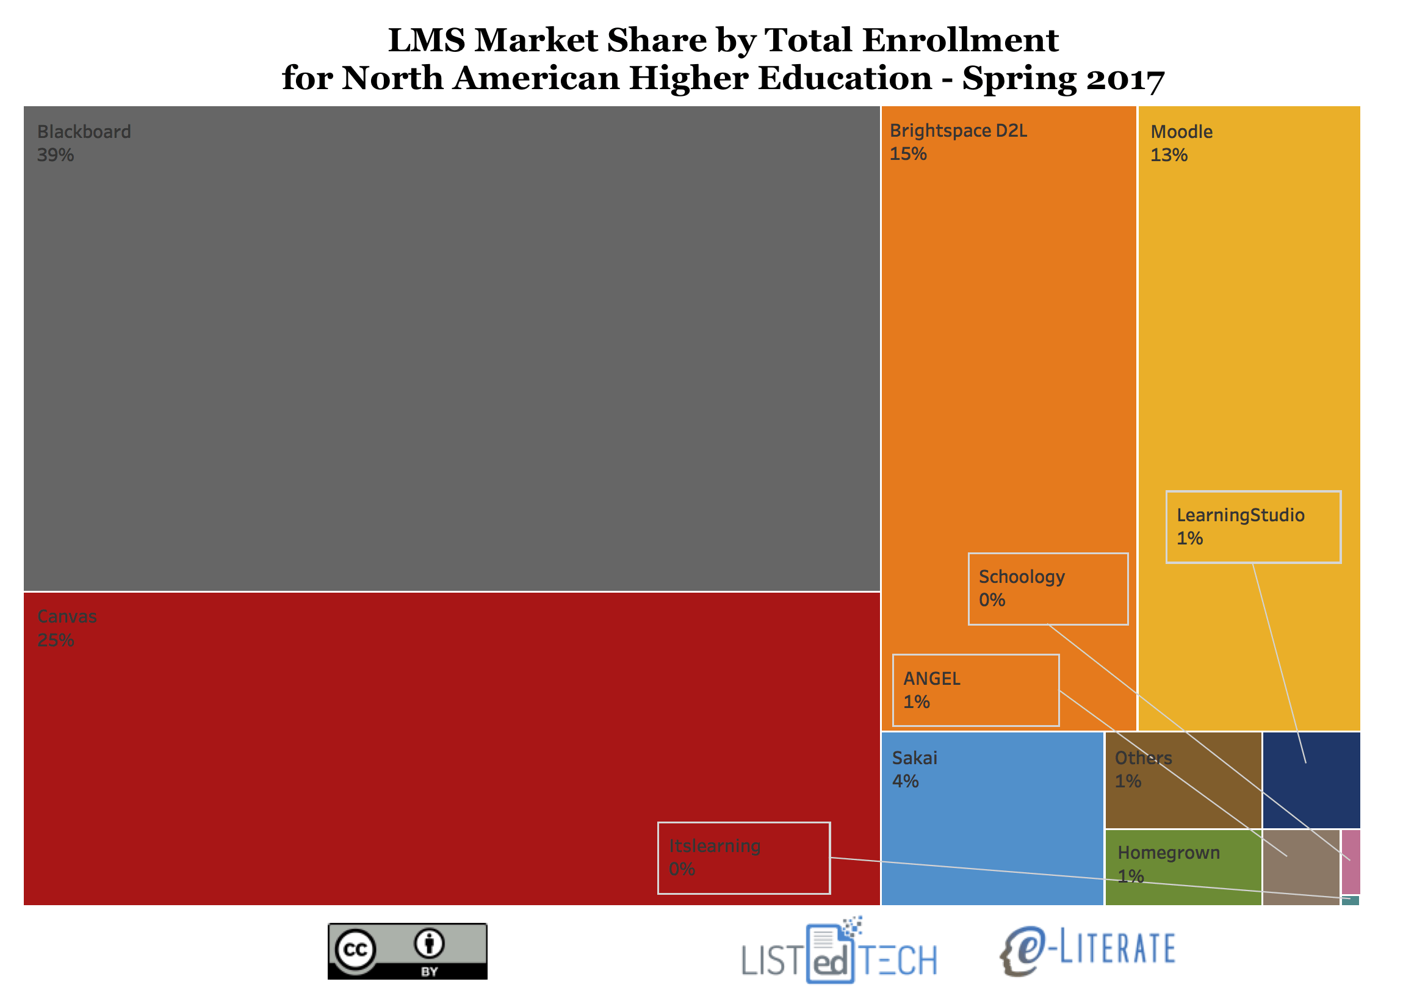
LMS Market Share May 2017
Notes:
Source: http://mfeldstein.com/academic-lms-market-share-enrollments-part-deux/

Slide 8
Driving Principles
Usability (Desktop AND Mobile)
Pedagogical & Technical Needs
Dependability (system and company itself)
Cost

Slide 9
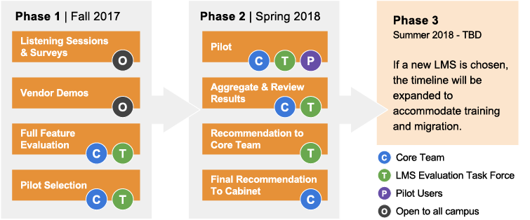
Timeline & Decision-Making

Slide 10
Three Possible Outcomes
Stay with Bb Learn
Switch to Brightspace or Canvas
Redo the Pilot

Slide 11
Core Team
Executive Sponsors: advocates & advisors
Dr. McCandless (VP of Information Technology Services)
Dr. Osborne (AVP Online & Alternative Delivery Programs)
Working Group: project mgmt + technical/financial evaluation
ATS (Brandon, Matt, Scott, Emily, and Steve)
Beth Stewart, CTE
Carolyn Kraut, UF Online

Slide 12
Task Force
1 faculty member from each college
1 rep from FTAC, Library, Registrar, Disability Services, Winebrenner, TaskStream, ePortfolio, Starfish
Still adding students
Role: teaching & learning evaluation, act as campus liaison

Slide 13
The Campus Community
Your Role
take the LMS Satisfaction survey
stay informed (www.findlay.edu/lms or use intranet)
attend open sessions
reach out to your campus liaison
give feedback & ask questions!

Slide 14
Upcoming Events
Aug 14 - Sept 15: Survey open (link on website, will be emailed)
September 27 @ 9:30a: ATS Techfast - LMS Preview
Oct 2-6: open sessions w/ vendors (exact time/date TBA)
Nov 29 @ noon: Nerd Lunch - Pilot Preview
Coming soon: monthly “Town Hall” meetings. The first will most likely be 2nd week of September.

Slide 15
Get Involved!
Go to www. findlay.edu/lms
Take the LMS Satisfaction survey.
Check the calendar for open sessions.
Submit feedback.

