Slide 1


WELCOME

Slide 2
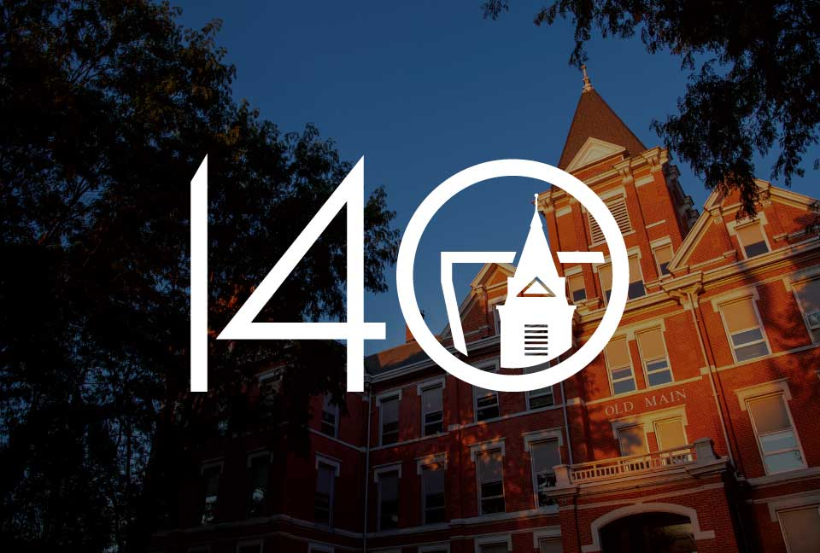
Welcome to the University of Findlay
Introduction: The University of Findlay (UF) is a private university located in Findlay, Ohio, USA.
Established: Founded in 1882 through a partnership between the Churches of God General Conference and the city of Findlay.
Campus: Spans over 76 acres with modern facilities and a vibrant campus life.
Student Body: Approximately 4,000 students from nearly 40 countries, fostering a diverse and inclusive environment.

Slide 3
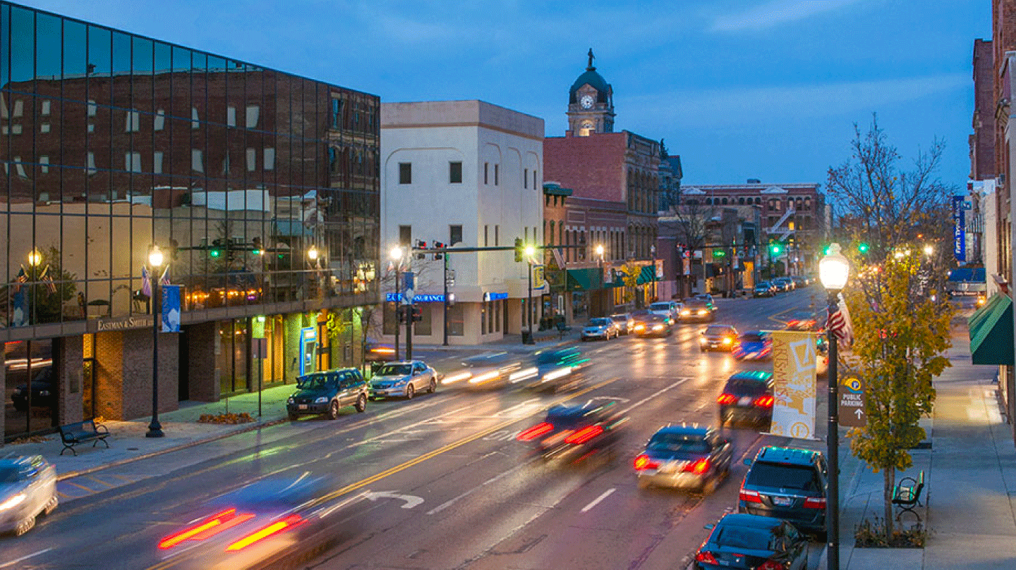

City of Findlay: #1 Micropolitan Community in United States
Small, safe city in Ohio with 40,000 people
Low Cost of Living:
  $50K annual salary in Findlay = a $126K annual salary in New York City to achieve the same economic status
Robust job market
  15 Fortune 500 companies located here
  7 Japanese, 2 Canadian & 3 German companies
Many restaurants, recreational opportunities and a historic downtown

Slide 4
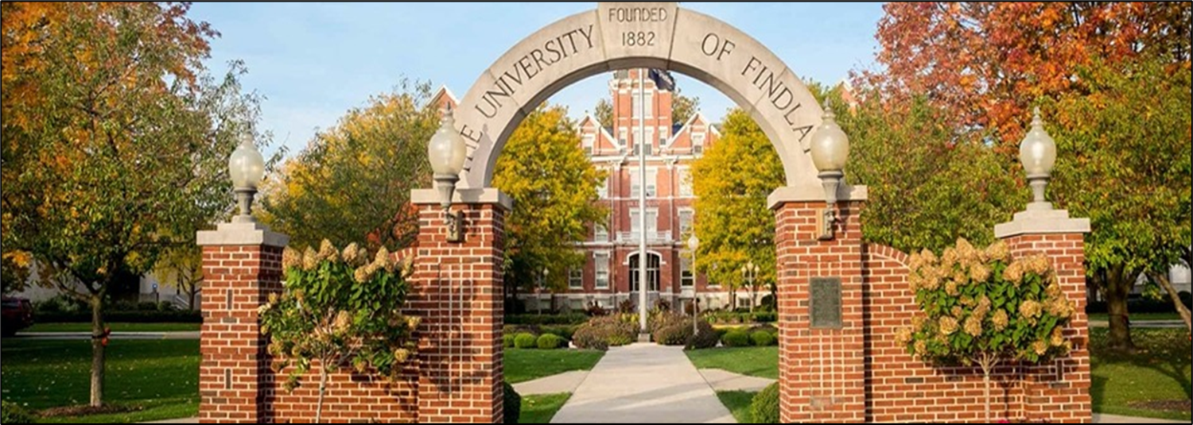
Admission Requirements and Cost of IELP
Admission Requirements
Passport
Financial Statement
Affidavit of Support
Tuition
Full Enrollment: $6,406
Part-time Enrollment: $718 per credit hour

Slide 5

Intensive English Language Program
(IELP)
IELP Mission: Three Goals
Enhance English proficiency
Support adjustment to U.S. life
Promote academic success.
IELP Features
Nationally Accredited by CEA through 2029.
Experienced faculty with over 100 years of collective experience.
Free tutoring through the ELL Support Center
Programming through Explore America program.
Safe and Secure environment to study.
Special Topics course can be tailored for groups with specific needs.
All IELP courses earn credit for undergraduate study.
Click here for more information.

Slide 6
Curriculum
IELP offers 4 levels of instruction.
Core courses (12 hours) Electives (6 hours)
Speaking and Listening (4 hours) Campus and Community (3 hours)
Reading and Vocabulary (4 hours) Academic Literacy (3 hours)
Writing and Grammar (4 hours) Special Topics – all skills (3 hours)
**Students select 2 electives per semester
LEVEL | TOEFL | IELTS
Level 1 | 17-31 | Up to 4.5
Level 2 | 32-44 | 5
Level 3 – Advance to Undergraduate program upon completion | 45-60 | 5.5
Level 4 – Advance to Graduate program upon completion | 61-78 | 6.0+

Slide 7
English Language Learner (ELL) Support Center
Provides free tutoring services for IELP students
  Conversation practice
  Test-taking strategies
  Paper editing
  APA format
  Avoiding plagiarism
  Vocabulary development
  Pronunciation clarity
  Cultural norms/classroom expectations
  and more!

Slide 8

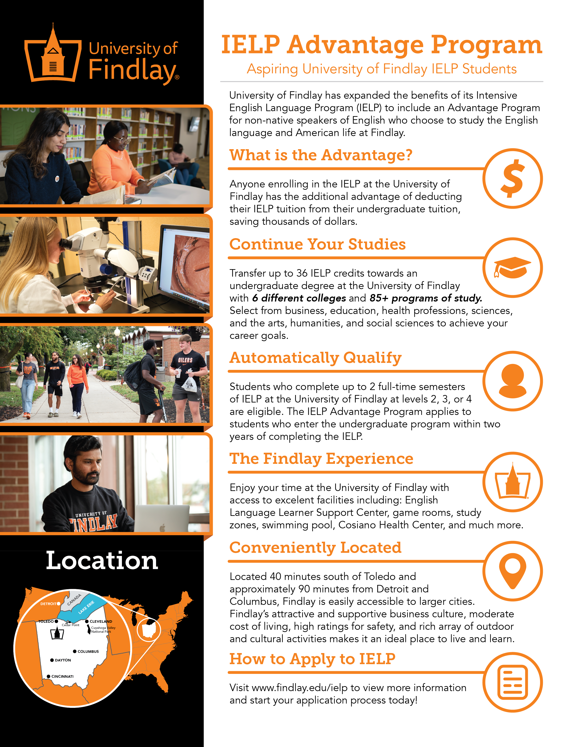
IELP
ADVANTAGE
PROGRAM

Slide 9
IELP Advantage – one semester
$7,000
Student spends one semester in IELP level 3, and becomes eligible for UG study.
$7,000/
7 UG semesters
IELP tuition converts into a tuition credit for UG study.
IELP Advantage Credit = $1,000
Student earns IELP Advantage each of 7 semesters of UG

Slide 10
IELP Advantage – two semesters
$14,000
Student spends two semesters in IELP levels 2 and 3, and becomes eligible for UG study.
$14,000/
7 UG semesters
IELP tuition converts into a tuition credit for UG study.
IELP Advantage Credit = $2,000
Student earns IELP Advantage each of 7 semesters of UG

Slide 11
Commission Structure
The University agrees to pay a flat-rate commission fee per international student referred by the Contractor who enrolls full-time in an academic program from Findlay’s Graduate, Undergraduate and IELP offering. Commission payments will be divided over the student’s first two semesters, and eligibility requires that the student clears all tuition balances in both semesters. Commission rates per intake are as follows:
1 - 7 Students:
$1,750 - 1st semester
$1,750 - 2nd semester
Total: $3,500 per student
8 or More Students:
$2,250 - 1st semester
$2,250 - 2nd semester
Total: $4,500 per student
Note: The increased rate of $1,000 begins with the 8th student in a single intake. All students must be enrolled full-time and financially cleared in each semester for commission eligibility.

Slide 12







