Slide 1
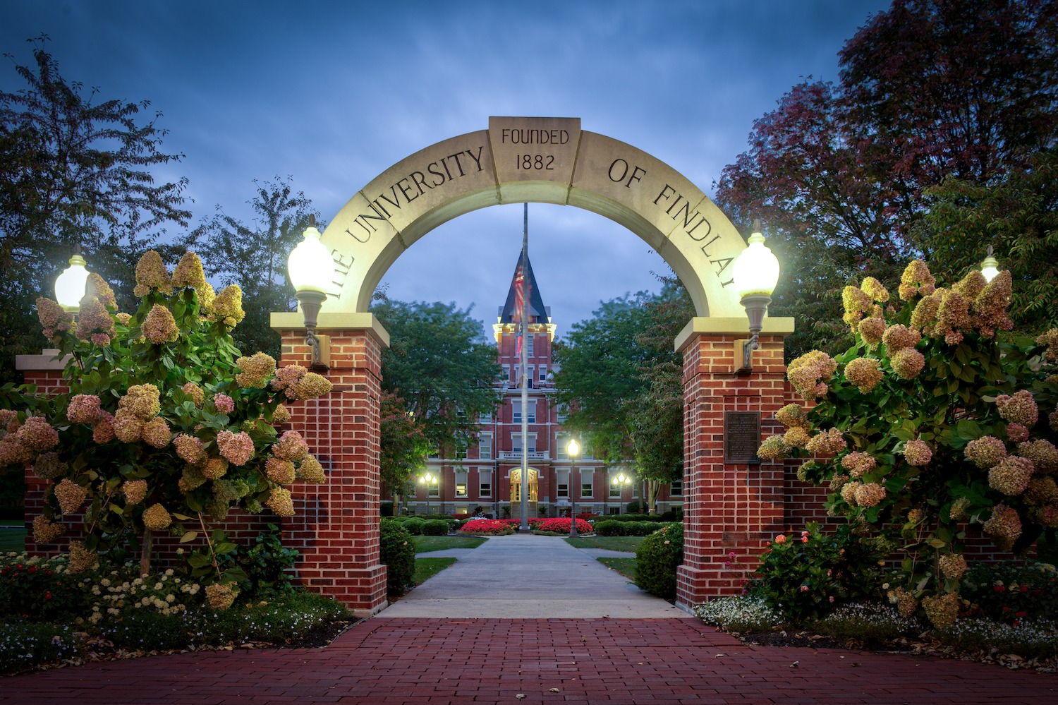
UNIVERSITY OF FINDLAY
Meaningful Life and Productive Careers.

Slide 2
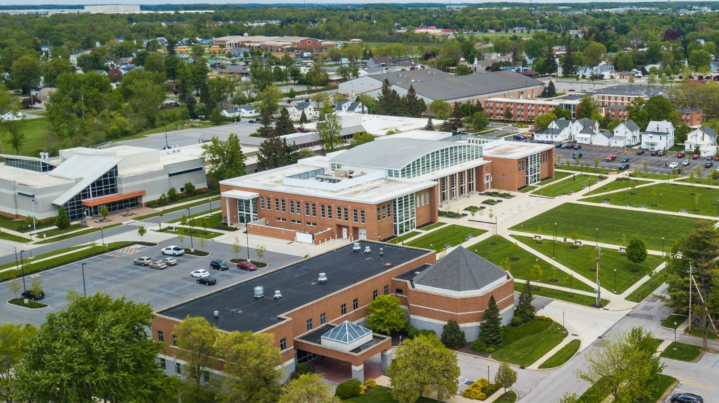
Notes:
Established in 1882, the mission of the University of Findlay is “To equip students for meaningful lives and productive careers.” Everything our faculty and staff do is focused on helping not only find a career that they love, but also to develop them as individuals who contribute to making the world a better place.

Slide 3
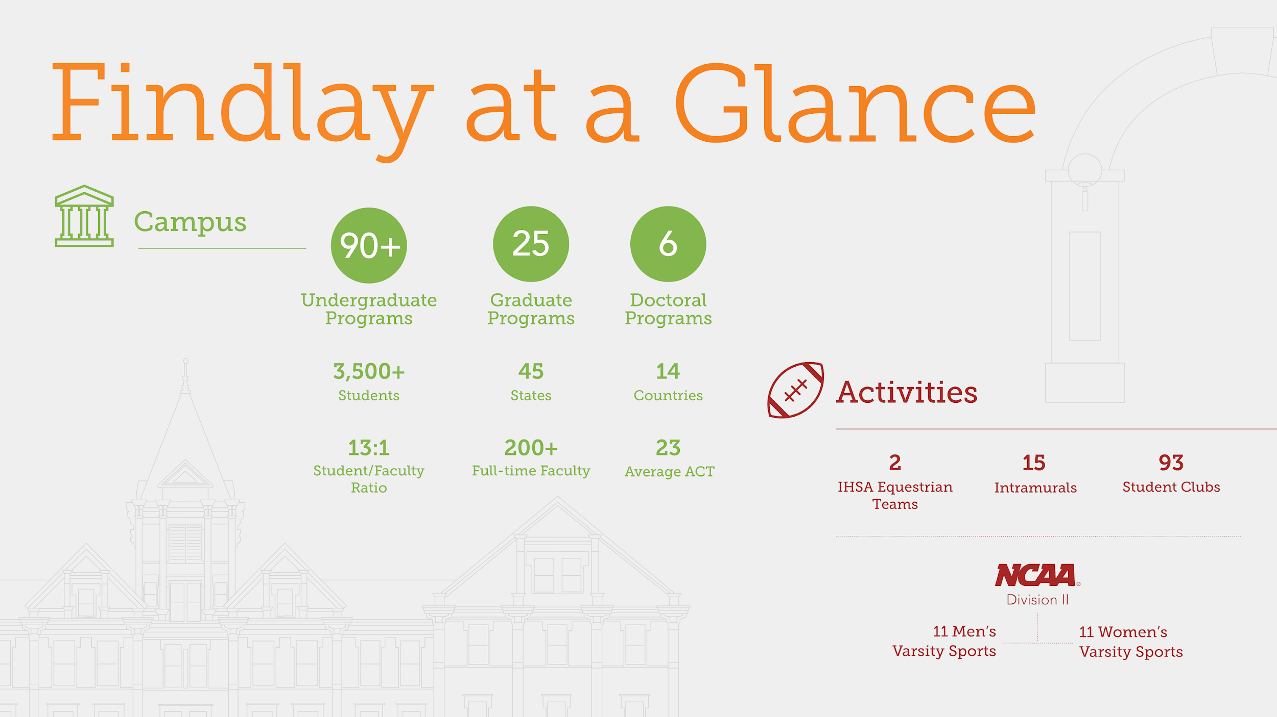
Notes:
UF has 84 bachelor’s degrees, 11 master’s degrees and five doctoral degrees. More than 3,500 students and a 16-1 student to faculty ratio.
^{ACCREDITED}

Slide 4
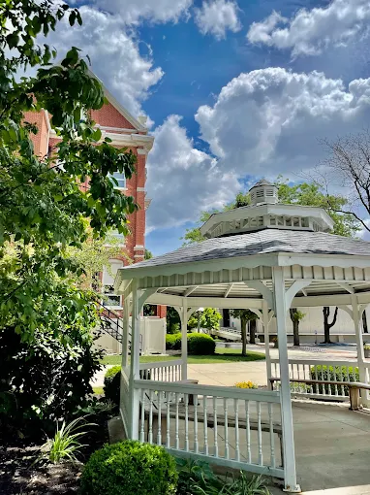
National Rankings
The University of Findlay is nationally recognized for its quality academic programs and exceptional student experience.
Highlights:
Ranked among America’s Best Colleges for 20 consecutive years — U.S. News & World Report
Named one of the Best Midwest Colleges (2026) — Princeton Review
Listed among America’s Best Colleges (2024) — Money Magazine
Ranked #1 Nationwide for Church of God–Affiliated Colleges — College Factual
At Findlay, our greatest recognition comes from the success of our students and alumni.
Notes:
Established in 1882, the University of Findlay is known for high quality academic programs. We have a strong national and international reputation for providing high quality programs and opportunities for students to get real experience before they graduate. We have been named a “Best in the Midwest” by U.S. News and World Report for several years. We have been named a “Best Midwestern College” by the Princeton Review and we have earned national honors for campus beauty and environmental efforts.

Slide 5
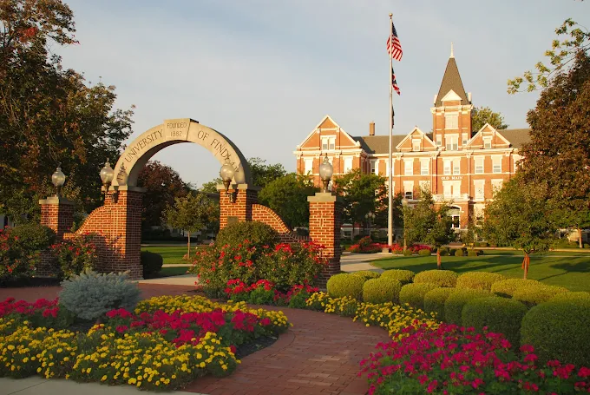
Location
Located in the Midwest Part of the United States, close to major cities and airports.
Toledo 1 hr.
Columbus 2 hrs.
Detroit 2 hrs.
Cleveland 2.5 hrs.
Cincinnati 2.5 hrs.
Pittsburgh 4 hrs.
Chicago 4 hrs.
New York 9 hrs.

Slide 6
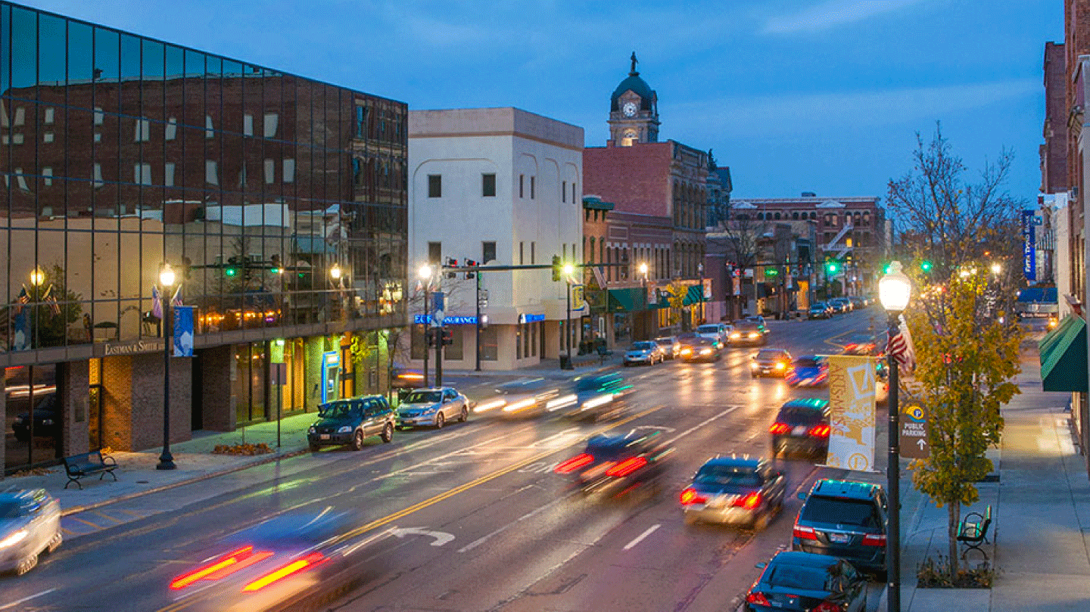
City of Findlay: #1 Micropolitan Community in United States
1. Small, safe city in northwest Ohio with 40,000 residents
2. Low cost of living:
  A $50K salary in Findlay equals about a $126K salary in New York City for the same lifestyle
3. Robust job market:
  Home to 15 Fortune 500 companies
  Includes 7 Japanese, 2 Canadian, and 3 German companies
4. Many restaurants, parks, and recreational opportunities
5. Historic downtown with shopping, cafés, and community events
Notes:
Located in the northwest region of Ohio, Findlay is a well-established city of 40,000 people with a vibrant atmosphere. Findlay boasts a number of recreational opportunities, an historic downtown, unique shopping, plenty of places to stay, a variety of dining and increasing business growth. With a small-town feel, Findlay allows its offers the comforts of home and the excitement of a growing city.

Slide 7
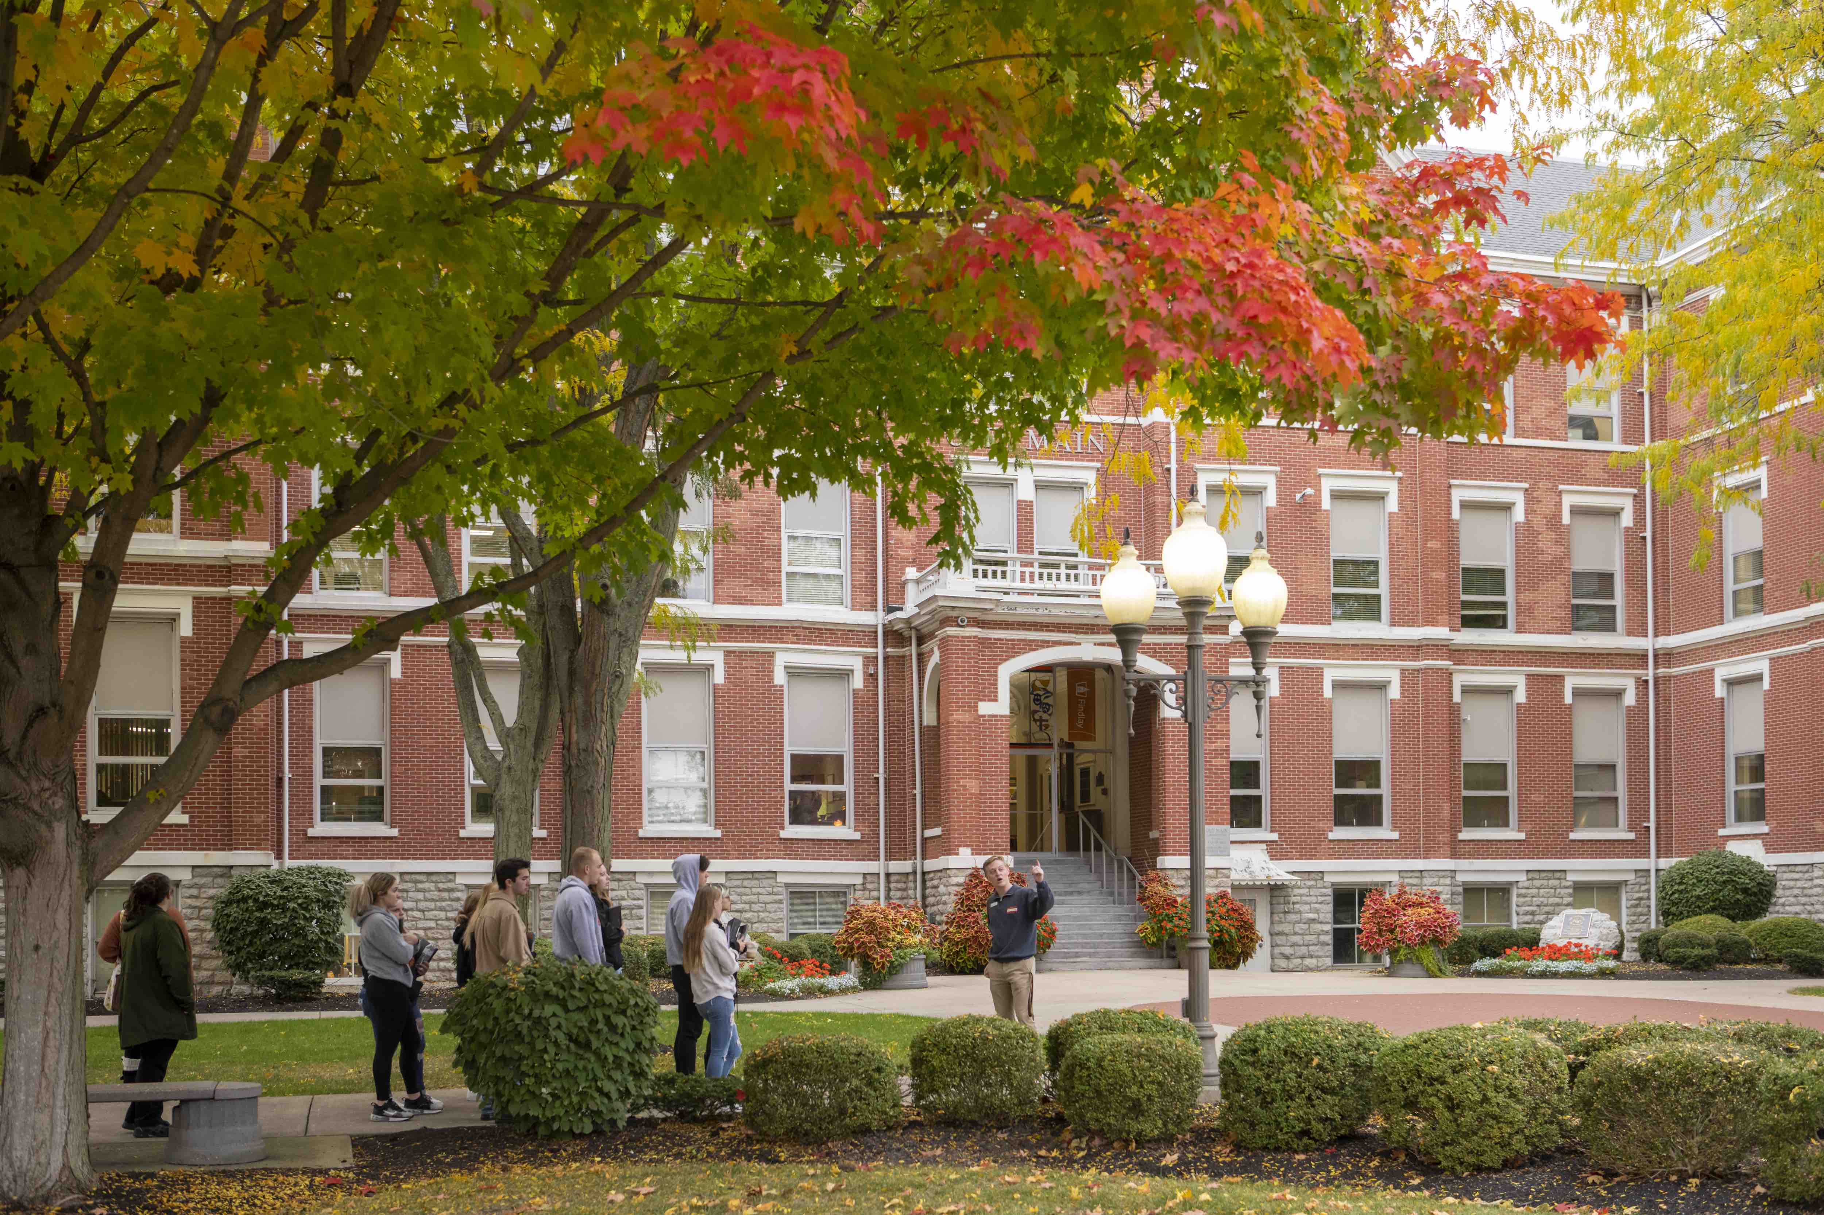
Weather in Findlay
☀️ Summer
Average High: 82°F / 28°C
Average Low: 62°F / 17°C
❄️ Winter
Average High: 35°F / 2°C
Average Low: 21°F / -6°C

Slide 8
Academic Program Overview
Notes:
Established in 1882, the University of Findlay is known for high quality academic programs. We have a strong national and international reputation for providing high quality programs and opportunities for students to get real experience before they graduate. We have been named a “Best in the Midwest” by U.S. News and World Report for ten consecutive years. We have been named a “Best Midwestern College” by the Princeton Review and we have earned national honors the last two years for campus beauty and environmental efforts.

Slide 9
Popular Programs For International Students
1. Environmental, Health, Safety & Sustainability (undergraduate & graduate)
2. MBA- Business Analytics
3. Computer Science & Applied Analytics
4. Health Informatics
5. TESOL
6. Business Administration
7. Nursing
8. Intensive English Language Program ( IELP)
Notes:
UF offers many nationally known, outcomes-based programs that are geared to help you build the experience and network you need to be successful in your chosen career. From our Environmental, Safety and Occupational Health Program that boasts a 100% job and internship placement rate; to the College of Education’s outstanding student satisfaction performance rating and the College of Health Profession’s 99% employment rate, you will find a program at UF that you will thrive in.

Slide 10
M.S. Environmental, Safety & Health Management
2-year program
Fully accredited by EHAC (one of only 9 programs in the USA)
Specializations: Safety Leadership (BCSP Qualified Academic Program) and Environmental Health (EHAC Accredited)
Career focused program
Cost of program: Approximately $27,360
Notes:
Established in 1882, the University of Findlay is known for high quality academic programs. We have a strong national and international reputation for providing high quality programs and opportunities for students to get real experience before they graduate. We have been named a “Best in the Midwest” by U.S. News and World Report for ten consecutive years. We have been named a “Best Midwestern College” by the Princeton Review and we have earned national honors the last two years for campus beauty and environmental efforts.

Slide 11
M.S. in Health Informatics
#1 MSHI program in the USA
2-year program
Fully accredited by the Higher Learning Commission (HLC)
Influence the future of healthcare through the use of health informatics and technology.
Cost of program: Approximately $27,720.00
Notes:
Established in 1882, the University of Findlay is known for high quality academic programs. We have a strong national and international reputation for providing high quality programs and opportunities for students to get real experience before they graduate. We have been named a “Best in the Midwest” by U.S. News and World Report for ten consecutive years. We have been named a “Best Midwestern College” by the Princeton Review and we have earned national honors the last two years for campus beauty and environmental efforts.

Slide 12
Master of Science in Applied Security and Analytics
2-year program
Courses cover project management, data mining, secure coding, and predictive analysis
Prepares professionals for high-demand roles in data and security management
Average earning potential ranges from $100K–$280K depending on position
Classes begin each fall and spring semester
Cost of program: Approximately $28,220
Notes:
Established in 1882, the University of Findlay is known for high quality academic programs. We have a strong national and international reputation for providing high quality programs and opportunities for students to get real experience before they graduate. We have been named a “Best in the Midwest” by U.S. News and World Report for ten consecutive years. We have been named a “Best Midwestern College” by the Princeton Review and we have earned national honors the last two years for campus beauty and environmental efforts.

Slide 13
Master of Arts in TESOL & Applied Linguistics
36-credit program — final semester dedicated to writing, presenting, and defending a thesis
Two-year master’s program
Admission requirements: Minimum 2.5 GPA (3.0 preferred) on a 4.0 scale and proof of English proficiency for international students
36-credit hour program that consists of eight required courses (including a thesis course) and 12 elective hours
Total estimated program cost: Approximately $20,160

Slide 14
Master of Business Administration
Earn your MBA in as little as one year (full-time) or about two years (part-time)
ACBSP-accredited College of Business
Five concentrations available: Business Administration, Business Analytics, Certified Public Accountant (CPA), Certified Management, Accountant (CMA), Healthcare Management
Learn to analyze, strategize, and lead in a global business environment
Cost of the program: Approximately $24,420
Notes:
Established in 1882, the University of Findlay is known for high quality academic programs. We have a strong national and international reputation for providing high quality programs and opportunities for students to get real experience before they graduate. We have been named a “Best in the Midwest” by U.S. News and World Report for ten consecutive years. We have been named a “Best Midwestern College” by the Princeton Review and we have earned national honors the last two years for campus beauty and environmental efforts.

Slide 15
Designed to help international students improve English proficiency and succeed academically
Builds confidence through language learning, cultural engagement, and classroom integration
Completing IELP fulfills English proficiency requirements for degree admission
Level 3 qualifies for undergraduate programs
Level 4 qualifies for graduate programs
Students benefit from experienced instructors, modern facilities, and CEA accreditation
Access to ELL support services, campus activities, and opportunities for cultural immersion
Cost of the program: Approximately $6,406 per semester
Intensive English Language Program-IELP

Slide 16
CAMPUS LIFE

Slide 17

BE ACTIVE
24 intercollegiate sports – NCAA Division II and IHSA
15 intramural sports – including sand volleyball and ultimate frisbee
1. Gym
2. Swimming Pool
3. Cardio Center
4. Indoor Tracks
5. Climbing Wall
6. Racquetball and Pickleball Court
7. Video Game
Notes:
UF offers many nationally known, outcomes-based programs that are geared to help you build the experience and network you need to be successful in your chosen career. From our Environmental, Safety and Occupational Health Program that boasts a 100% job and internship placement rate; to the College of Education’s outstanding student satisfaction performance rating and the College of Health Profession’s 99% employment rate, you will find a program at UF that you will thrive in.

Slide 18
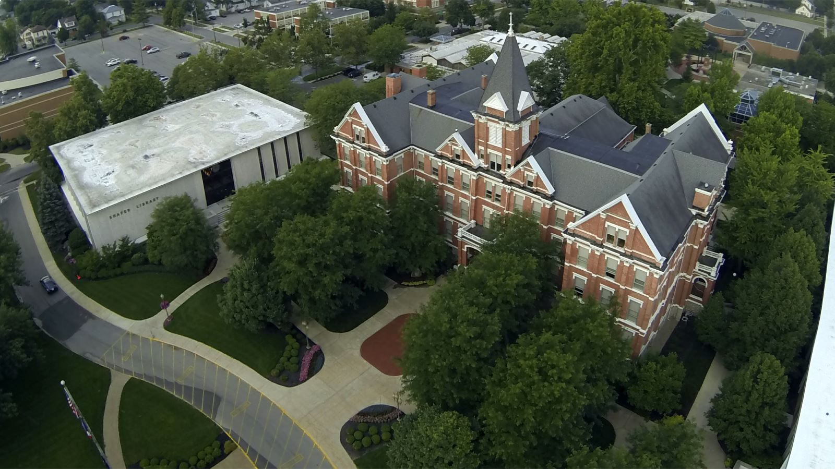
Main Campus Overview
86-acre main campus featuring:
Academic, administrative, and athletic buildings
8 residence halls, 19 townhouse units, 21 cottages, plus additional student houses and apartments
Housing & Food Cost: Approximately $15,400 per year
Notes:
Findlay has an undergraduate student body of 2,900 with 1,200 of them living on campus. With robust campus life programming and living and learning environments that range from traditional residence halls to apartments and houses, the experiences that are created and shared bond out students together long after graduation.

Slide 19

Housing Options
On-Campus Housing:
Residence halls, townhouses, cottages, and apartments available
Convenient access to classes, dining, and campus activities
Off-Campus Housing:
Apartments and rental homes within walking or short driving distance
Options for upperclassmen and graduate students
Meal Plans:
Multiple dining options and flexible meal plans available

Slide 20



Dining Services
Dining Services is a full service dining operation that serves the entire campus community, and offers a variety of food and beverage options.
Meal plan cost and options can be reviewed with the International Admissions Counselors in detail.

Slide 21
Application Criteria and Process
Notes:
Established in 1882, the University of Findlay is known for high quality academic programs. We have a strong national and international reputation for providing high quality programs and opportunities for students to get real experience before they graduate. We have been named a “Best in the Midwest” by U.S. News and World Report for ten consecutive years. We have been named a “Best Midwestern College” by the Princeton Review and we have earned national honors the last two years for campus beauty and environmental efforts.

Slide 22

Application Process
1. Access the Application Link
2. Create an Account
3. Complete the Online Application Form
4. Submit the Application Form
5. Upload Necessary Documents
5. Pay the $75 Application Fee
6. Application Review

Slide 23
Admission Requirements
UNDERGRADUATE
High school transcripts
School leaving certificate or diploma​
​Copy of passport bio page
English Test Score (TOEFL, IELTS, PTE, Duolingo)
GRADUATE
Undergraduate degree
Transcripts
​Copy of passport bio page
English Test Score (TOEFL, IELTS, PTE, Duolingo)
MATESOL and MA in Rhetoric and Writing program require letters of recommendation.

Slide 24

I-20 Issuance
Post-Admission Steps:
1. Accept the Offer of Admission
2. Pay the $500 Deposit
3. Upload Financial Documents
4. Issuance of I-20

Slide 25

Deposit and Refund Policy
$500 Enrollment Deposit is applied to the student account after enrollment. It is non-refundable, except for F-1 visa denials (Section 214b).
Refund Eligibility (Visa Denial Only):
1. Application must be within 2-year deferral window
2. Email international@findlay.edu before the visa interview
3. Within 10 days after the interview, email:
  - Screenshot of visa denial result
  - Note requesting deferral or refund
4. $50 processing fee is deducted from approved refunds

Slide 26

International Student Scholarships
​​​International Graduate Scholarship | ​$750 per academic semester (excluding summer)
​IELP Scholarship | ​$750 per academic semester (excluding summer)​

Slide 27
2027-2028 First-Time Freshman Merit Scholarships
Scholarship | GPA | Award | Test – ACT/SAT/CLT
Trustee | 4.0 or higher | $25,000 | ACT: 27 / SAT: 1290 / CLT: 89
Presidential | 3.9 | $24,000 | ACT: 24 / SAT: 1190 / CLT: 79
Deans | 3.65 | $22,500 | ACT: 21 / SAT: 1090 / CLT: 67
Faculty | 3.3 | $20,000 | N/A
Merit | 3.29 or lower | $18,500 | N/A

Slide 28
2027-2028 Transfer Merit Scholarships
**Amounts based off of cumulative transfer GPA
Scholarship Name | GPA | Scholarship Amount
Trustee | 3.5 or higher | $25,000
Deans | 3.0 - 3.5 | $22,500
Merit | Up to 2.99 | $18,500

Slide 29
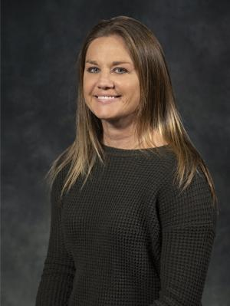
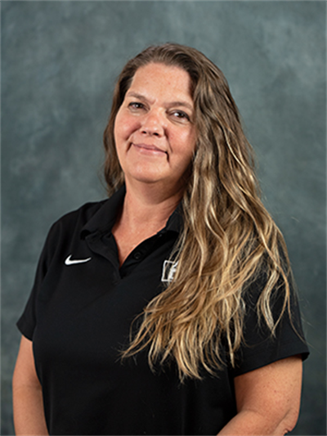
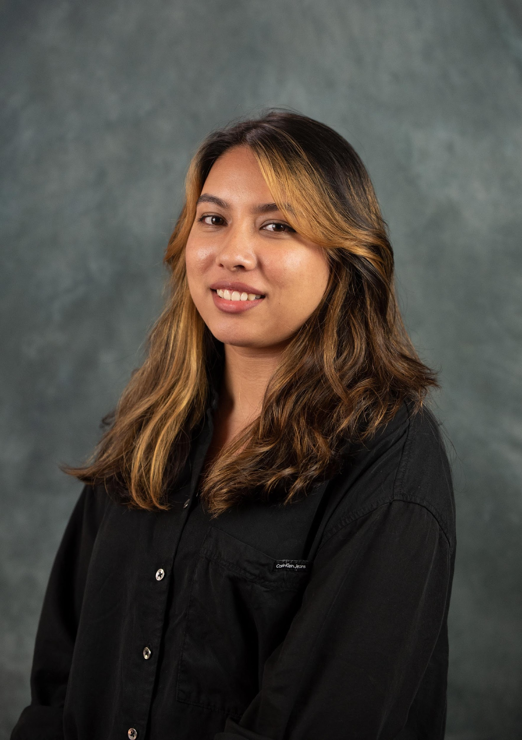
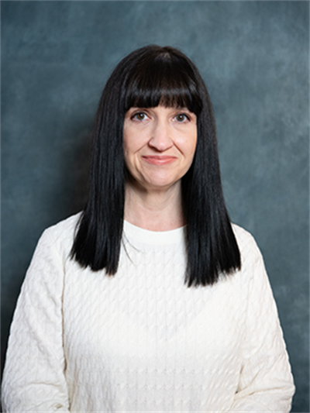
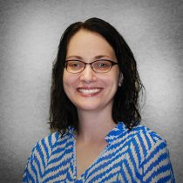
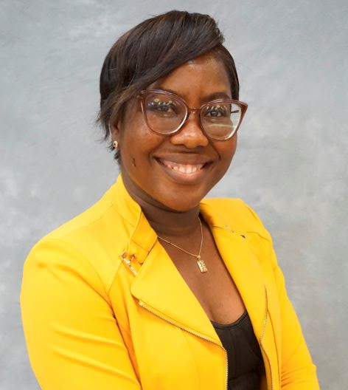
Nikki Hintze
Vice President of Enrollment &Marketing
Debbie VanAtta
Assistant Director of International Admissions & Immigration Services
Minal Bista
International and Graduate Enrollment Specialist
Kathy Patton
Director of Graduate and International Admissions
Megan Fowler
Director of Admissions Operation and International Admissions Recruiter Relations Coordinator
Belinda Gewu
International and Graduate Enrollment Specialist
Follow us on Facebook!
@FindlayIntlAdmissions
Questions?
international@findlay.edu

