Slide 1
All Things Curricular Assessment
Valerie Escobedo, co-chair
Joyce Lammers, co-chair
Helen Schneider, Taskstream “guru”

Slide 2
Our Committee
COB: Louann Cummings and Brent Wickham
COE: Kathy Crates and Gwynne Rife
COHP: Joyce Lammers and Bart Welte
COLA: Val Escobedo and Nikki Diederich
COPH: Sandy Earle and Erin Thompson
COS: Paul Langhals and Erin Alava
Ex Officio and non voting:
College Deans
Associate VP for Academic Affairs and Institutional Effectiveness (John Osae-Kwapong)
Director of External Affairs (Sara Hingson)
Registrar (Tony Goedde)
Assessment/Evaluation and Database Training Liaison (Helen Schneider)
Non voting: Student Rep.
Notes:
COB: E. Renshler
COE: J.McIntosh,
COHP: R. States
COLA: R. Tulley,
COPH: D. Parker
COS:J. Frye,

Slide 3
Review Teams 1-2
Team 1 Erin Thompson and Paul Langhals
Accounting (BS, AA, minor)
Animal Science (BS)
English (BA, minor, writing minor)
International Business (BS, minor)
Law and Liberal Arts (BA, minor)
Operations and Logistics (BS, minor)
Team 2 Bart Welte and Louann Cummings
Biology (BS, minor)
English as an International Language (certificate)
Gender Studies (minor, certificate)
History (BA, minor)
Religious Studies (BA, minor)
TESOL (MA, BA)

Slide 4
Review Teams 3-4
Team 3 Gwynne Rife and Brent Wickham
Applied Security Analytics (MS)
Computer Science (BS, AA, minor, Info. Processing minor, Info. Assurance certificate)
Health Informatics (MS)
Nuclear Medicine Technology (BS, AA, certificate)
Nursing (BS)
Positron Emission Tomography/Computed Tomography (BS, AA)
Team 4 Kathy Crates and Nikki Diederich
Chemistry (BS, minor)
Coaching (minor)
Echocardiography (BS, AA, Certificate)
Health and Physical Education (BS)
Management Information Systems (AA, certificate)
Physical Therapy (DPT, BS with Pre-PT emphasis)
Sonography: Diagnostic Medical, Vascular (BS, AA)
Sociology (minor)

Slide 5
Review Teams 5-6
Team 5 Valerie Escobedo and Joyce Lammers
Doctor of Education
Pharmacy (PharmD)
International/Intercultural Studies (minor)
Philosophy (BA, minor, minor in Philosophy/Applied Ethics)
Master of Physician Assistant
Team 6 Sandy Earle and Erin Alava
Business Information Assurance Management (minor)
Business Economics (minor)
Early Childhood (BS)
Economics (BS, minor, certificate)
Intervention Specialist (BS)
Middle Childhood (BA/BS)
Second Language Education (minor)
Wellness and Exercise Promotion (BS)

Slide 6
Where to Go for Information? BLACKBOARD
Go to “My Organizations” and enroll into “Taskstream”
Go to “Assess Programs/AMS”
Then go to folder “Curricular Program Assessment”

Slide 7
What’s new and different since 2015 . . .
SCORING AND RUBRICS
Meets, Meets with Concerns, Does Not Meet (2,1,0)
May result in lower average scores than 2015
CURRICULUM MAPPING
Recommended in 2015 – Now Required – Knowledge, Skill, Disposition
PROGRAM SPECIFIC MISSION STATEMENT
Recommended in 2015 – Now Required

Slide 8
What’s new and different since 2015 . . .
MINORS AND EMPHASIS AREAS
If minor/s or emphasis areas are embedded in a major and share the same learning outcomes they may be assessed within the major workspace.
Complete the narrative section for minor or emphasis area and guide reviewer to major
AA’S AND CERTIFICATES
If the lower levels of the degree are embedded in the bachelor’s degree program and share the same learning outcomes, certificates and associate programs may be assessed within the bachelor’s degree workspace.
Complete the narrative section for AA or certificate area and guide reviewer to major

Slide 9
Expedited Submission - We listened
Eligible academic programs will be required to:
Complete the narrative section
Reflect on the current status of actions plans created during the last assessment cycle
Provide a program specific mission statement
Provide appropriate curriculum map/s organized by Knowledge, Skills, and Dispositions
It is still the expectation of the Curricular Assessment Committee that academic programs will continuously collect and analyze assessment data. However, a full submission will not be required during every review cycle.
Notes:
The expedited submission option has been developed in response to your voices and suggestions asking that every year not be a full submission year. What is it? Expedited submission allows an eligible academic program to complete only the narrative and action plan portions (including reflection on past action plans) within the Curricular Assessment review space. Programs that are eligible for an expedited submission are asked to address all categories in which they have received a one (if applicable) during the last assessment cycle. NOTE: It is still the expectation of the Curricular Assessment Committee that academic programs will continuously collect and analyze assessment data. However, a full submission will not be required during every review cycle. The expedited submission option has been developed in response to your voices and suggestions asking that every year not be a full submission year.

Slide 10
Expedited Submission- How do you earn it?
This year, and moving forward, programs will have the opportunity for an expedited submission if they meet the following eligibility requirements:
the program’s overall assessment score for the last curricular assessment cycle was above the overall institutional average
the program did not receive a score of 0 in any category and/or more than one zero in any sub-score for a category
the program is using the same program outcomes for Curricular Assessment as during the past cycle
the program has not used an expedited submission in the previous review cycle.
Notes:
The expedited submission option has been developed in response to your voices and suggestions asking that every year not be a full submission year. What is it? Expedited submission allows an eligible academic program to complete only the narrative and action plan portions (including reflection on past action plans) within the Curricular Assessment review space. Programs that are eligible for an expedited submission are asked to address all categories in which they have received a one (if applicable) during the last assessment cycle. NOTE: It is still the expectation of the Curricular Assessment Committee that academic programs will continuously collect and analyze assessment data. However, a full submission will not be required during every review cycle. The expedited submission option has been developed in response to your voices and suggestions asking that every year not be a full submission year.

Slide 11
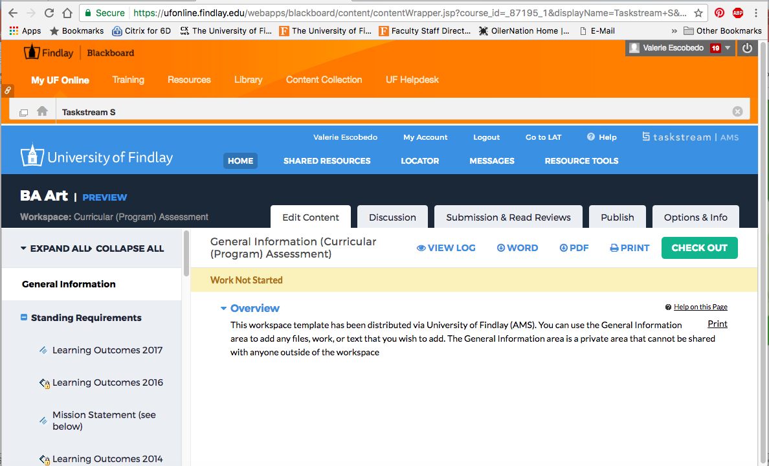
Workspace Facelift

Slide 12
What’s the same . . .
Two year cycle for submissions
Knowledge, Skill, Disposition (KSD) – one outcome per KSD to be assessed
Internal curricular assessment itself – should be meaningful for you
Due date: last Friday in September (September 29)
Help Sessions in the Learning Commons
Monday-Thursday 3-5 after Labor Day

Slide 13
Work/Help Sessions in Learning Commons Monday- Thursday, 3-5 pm Dates:
Sept. 5, 6, and 7
Sept. 11-14
Sept. 18-21
Sept. 25 – 28

Slide 14
Preliminary Advice
Work with your department or assessment team.
Be sure to provide analysis when asked for in different spots in the Taskstream template.
Be sure to fill out all sections of the template as applies to your submission status.
Make the analysis, reflection, recommendations, actions, and narrative useful for your context. That is the point! ☺
Contact your reviewers, the committee co-chairs, and Helen. We are here to help.

Slide 15
And now . . .
Questions?

